Slide 1
Mid-Point Review
**Mandatory requirement by the Federal Register**

Slide 2
Required Mid-Point Review
Mar/Apr
Identifies strengths and weaknesses in areas of contributions to the objectives
Employee writes mid-point assessment statements using the mandatory assessment writing format (What-Result-Impact)
Any deficiencies or inadequate level of contribution must be documented and a reasonable period of time established for the employee to improve
Review progress against Individual Development Plan goals, continuous learning points and, if applicable, certification
Provides an opportunity to modify contribution plans if necessary
Documentation is completed in CAS2Net

Slide 3
Writing a CCAS Assessments for Mid-Point, Closeout and Annual Appraisals

Slide 4
Employee and Supervisor Assessments
Need for Good Assessments
Employee and supervisor assessments of performance are crucial to the pay pool panel members when they are reviewing ratings
Rating recommendations reviewed by the pay pool panel must contain sufficient information to justify the rating before a final rating is approved
Job Achievement &/or Innovation
Mission Support
Communication &/or Teamwork

Slide 5
Capturing Contributions throughout the year
The advantage of using CAS2Net right from the start is that the system already has separate tabs for you to enter your contribution results for each of the factors and keeps count of the characters used as your enter your text
Although the user receives warnings, the system times out if no information is saved or submitted within a 15 minute timeframe. Any information that has not been saved is at risk if the system times out, so be sure to save frequently when using CAS2Net

Slide 6
Preparing for the Self-Assessment
  Review the contribution plan
  Assess by factor, assess contributions against factor descriptors / discriminators
For the annual, review the Mid-Point and, if applicable, Closeouts
Remember that with CCAS, results are measured relative to salary level

Slide 7
What are Significant Accomplishments?
The following are characteristics of significant accomplishments:
  DoD/Air Force/Command/PEO/Program-wide Impact
  High Level of Difficulty
  Representing your organization in Inter Agency Forums
  One of a Kind
  First Time
  High Visibility
  Wide Scope of Coordination
  Short Deadlines
  Competing Priorities
  Require Innovative Problem Solving

Slide 8
Self-Assessments
Mid-Point, Closeout and Annual Appraisal Self-Assessments are meant to document measurable results, portray a concise picture of contributions, and communicate the impact made to the organization’s strategic goals
It’s best to assume your supervisor doesn’t have a complete picture of all of your most impactful contributions; use your self-assessment to provide it
With proper tracking of the contributions you make throughout the year, you can significantly reduce the amount of time needed to write an effective self-assessment
Your self-assessment need not document every one of your contributions. However, ensure you address items you stated you would accomplish in your Contribution Plan

Slide 9
Self-Assessments (cont.)
A verbose or disorganized assessment serves only to make the annual appraisal process unnecessarily difficult
There is an expectation that the routine tasks you’ve accomplished are appropriate for your pay level. Rather, try to concisely highlight your contributions that had the biggest impact on accomplishing the goals of your organization as these are the ones most likely to be valued by the pay pool
Each factor must be addressed separately. As a first step, for each factor determine which level descriptors best match your contributions. Be sure to obtain a copy of the factor descriptors for the broadband level to which you are assigned, as well as the levels immediately above and below, before beginning to write a self-assessment

Slide 10
Writing A Self-Assessment
Begin with a named task, followed by results achieved, and ending with impact to the mission of the organization
For each assessment statement, make sure it passes the “SO WHAT” test
“I Did A that resulted in B,
and the impact of that contribution was C.”

Slide 11
Mandatory Self-Assessment Writing Method
(Mid-Point and Annual)

Slide 12
Mandatory Self Assessment Writing Method
What – Result – Impact (WRI)
Write a minimum of three W-R-I Statements for each factor for the annual appraisal. You will be rated on each factor individually
Employees use this format to address self assessment comments
Not required for supervisor annual assessment

Slide 13
Self-Assessment Writing Method
Identify the what to be addressed and make an accomplishment statement; the task, project, test, analysis, report, timecard, calendar
Document the result. Provide the quality, quantity, cost/budget, and timeliness details; be specific
Provide scope and scale of the impact that the contribution has on the mission; why did it matter
Provide this for each of the three factors
Job Achievement &/or Innovation
Mission Support
Communication &/or Teamwork

Slide 14
Writing A Self-Assessment
Make the connection between what was done and why that should matter to the organization
Note challenges that were encountered and how they were handled
Be specific (use dollar figures, program names, time saved, percentages, etc.)
Provide scope and scale of the impact that the contribution has on the mission
Use the factor descriptors and discriminators
WHAT – RESULT – IMPACT

Slide 15
Effective W-R-I Examples
NH-III
WHAT: Made the [Project] more affordable by implementing a change bundle process of 40 required changes and netted cost savings. This contribution meets the programmatic goals of affordability and efficiency.
RESULT: The result of the change bundle award provided $5M of funding for the program manager’s change budget and also removed forty changes from the 250 unadjudicated changes. The change bundle resulted in 16% reduction to the total change liability.
IMPACT: The change bundle saved $5M and significantly reduced the backlog by 40 changes. As agreement on the cost savings was reached in December and the change bundle was awarded in June to allow for the [contractor's] lengthy proposal certification process.

Slide 16
W-R-I Example
NH-IV
WHAT: Interacted with Defense Acquisition University and OSD(AT&L) personnel regarding sequestration funding cuts to DAU training and related furlough interruptions to the training program.
RESULT: Influenced DAU and OSD(AT&L) policies and direction through the interruptions for clearer path forward.
IMPACT: Maximized ability of AF personnel to receive required acquisition training.
WHAT: Led AF interaction with Defense Acquisition University and OSD(AT&L) personnel regarding sequestration funding cuts to DAU training and related furlough interruptions to the training program.
RESULT: Influenced DAU and OSD(AT&L) policies and direction through the interruptions for clearer path forward, received required funds and training quotas.
IMPACT: Maximized ability of AF personnel to receive required acquisition training despite unprecedented funding obstacles caused by budgetary reductions, sequestration, and government shutdown.
Better!

Slide 17
Writing A Self-Assessment
The set of descriptors for a particular factor and broadband level are to be taken as a group to decide whether an Employee fits the level
Seldom will your contributions perfectly match all of the descriptors in the set for a particular level, and it is not necessary to write something to match every descriptor
Employees should be trying to relate to the factors -- not match them -- and then it will be up to Supervisors and the Pay Pool Panel to interpret the descriptors to get a reasonable and equitable assessment of contribution
A contribution in an individual factor is not necessarily represented by a discrete activity; it may be but one facet of the activity
A single activity may well result in a contribution that applies to more than one factor.
  When this occurs do not simply copy and paste the exact same contribution statement as entries for multiple factors. Rather, use language from the unique descriptors of each factor to highlight how that contribution relates to that factor

Slide 18
Self-Assessment Summary
Be factual and emphasize how the task/action supports the mission
The annual appraisal self-assessment should not be a laundry list of skills an employee possesses; nor is it an assessment of potential
You should be specific when writing contribution statements. Do not leave it to others to presume contribution
Use dollar figures, program names, number of people supervised, time saved, percentages, dollars controlled, etc., where and when appropriate
Be accurate. Was the contribution made while the team leader or a team member
An activity may warrant mention under more than one factor
Remember to address: “WHAT: Did A RESULT: that resulted in B, then state IMPACT: how it was related to the mission.” Apply the So What test!

Slide 19
Mid-Point Self Assessment
Employee Menu
Contribution Planning
Mid-Point Review Self Assessment
Closeout Self Assessment
Annual Appraisal Self Assessment
Reports
eDocuments
Mid-Point Review Self Assessment for Joe Contributor
Year: 2018 
First Level Supervisor:
Broadband Level: III | Occupational Series: 1102 – Contract Specialist | Career Path: NH- Business Management and Technical Management Professional | Expected OCS Range: 64 – 68 -71
Contribution Planning:
Job Achievement and/or Innovation: Collaboration to promote acquisition planning & timely solutions to acquisition issues… Enhance communications internally & externally to support contracting enterprise mission… Leverage technology to enhance contracting enterprise capabilities and Accountability… Communication and/or Teamwork: Participate in strategic initiatives/improve enterprise performance Enhance communication internally and externally to support contracting enterprise mission


Job Achievement and/or Innovation | Communication and/or Teamwork | Mission Support
Job Achievement and/or Innovation
Employee Self Assessment |  |  | (Characters used: 0 of 4000)
Click
Descriptors and Discriminators
 Employee Narrative Complete
Save
Exit

Slide 20
Factors Review
    Descriptions
Factors (Same for All) | Factor Descriptions (Same for All)
Job Achievement and/or Innovation | This factor captures qualification, critical thinking, calculated risks, problem solving, leadership, supervision, and personal accountability aspects appropriate for the position classified to the broadband levels of the (NH/NJ/NK) career path.
Communication and/or Teamwork | This factor captures communication, both verbal and written: interactions with customers, coworkers, and groups; and assignments crossing functional boundaries appropriate for the positions classified to the broadband levels of the (NH/NK/NJ) career path.
Mission Support | This factor captures understanding and execution of organizational goals and priorities; working with customers to develop a mutual understanding of their requirements; monitoring and influencing cost parameters or work, tasks, and projects; and establishing priorities that reflect mission and organizational goals appropriate for the positions classified to the broadband levels of the (NH/NJ/NK) career path.

Slide 21
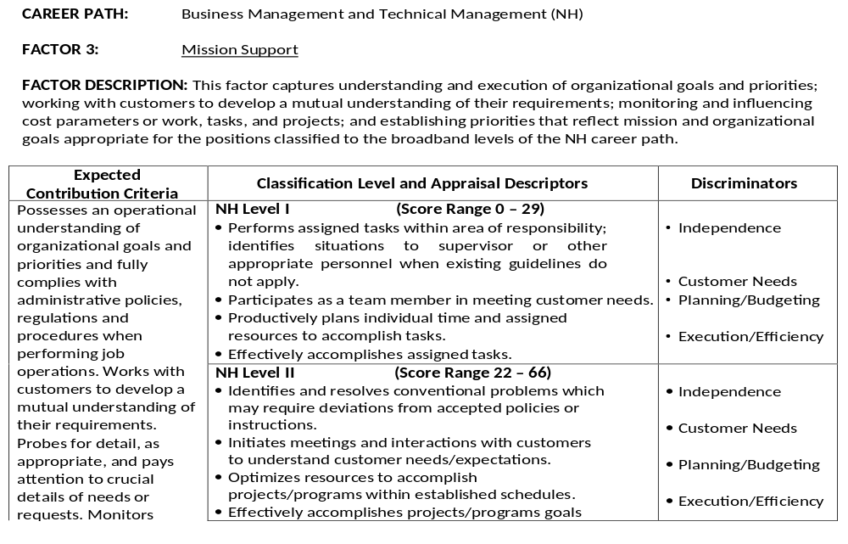
Factors Review
Sample Factor Structure

Slide 22
Supervisory Assessments
(Mid-Point and Annual)

Slide 23
Supervisory Assessment
Mid-Point
There should be no surprises to the employee at the end of the year
Provide constructive feedback
Is the employee on-track to meet or exceed goals
Do not copy/paste members comments
Expand on the employees individual factor self assessments as well as include significant contributions that the employee may have forgotten to provide
Base comments on contributions and results obtained by the employee during the rating period and not on the employee’s personality characteristics
Identify areas for performance enhancement and to help promote professional growth or if there are any issues

